Slide 1
MOVIES REVIEWS AND TRENDS
Lewis Jarrett & Abhishek Sharma : Group 7
PYTHON FOR DATA ANALYSIS – CATALYST

Slide 2
INTRODUCTION
We choose the dataset from Rotten Tomatoes which is one of the most popular film websites, combines movie information, critic reviews and users reviews.
Critics reviews categories:
Certified fresh: at least 75% of critics reviews are positive and 5 reviews come from top critics
Fresh: at least 60% of the critics reviews are positive
Rotten: less than 60% of the critics reviews are positive
Users reviews categories:
Upright: at least 60% of the users reviews are positive
Spilled: less than 60% of the users reviews are positive

Slide 3
OBJECTIVE / MOTIVATION OF ANALYSIS
The reason we chose this dataset is because we often see and hear in the media that films (and life in general) were “better” in the 60s and 70s. So we wanted to see how this reflects in the quality of cinema.
Investigating the reliability and impact of critics compared to audience perception
Ratings throughout the decades
Tracking the speed of the industry from theatres to streaming

Slide 4
HOW DO WE DEFINE SUCCESS?
• Most popular genre?
• Which decade could be considered the best and why?
• Who are the dominant studios/writers/actors/directors?
• Investigating the parity between critics and audience
• Investigate history of streaming compared with theatre dates / i.e. speed of industry

Slide 5
DATASET
The original movie dataset includes 16,638 movies with 23 (Columns) attributes such as:
movie description
critic consensus
Rating
Genre
Cast
Movies theater and streaming release dates
Rotten Tomatoes review scores.

Slide 6
DATA PROCESSING
Basic inspection
Fill or remove null values
Identifying outliers and key points
Removing irrelevant attributes
Creating additional relevant columns
Choosing which visualization methods may be important

Slide 7
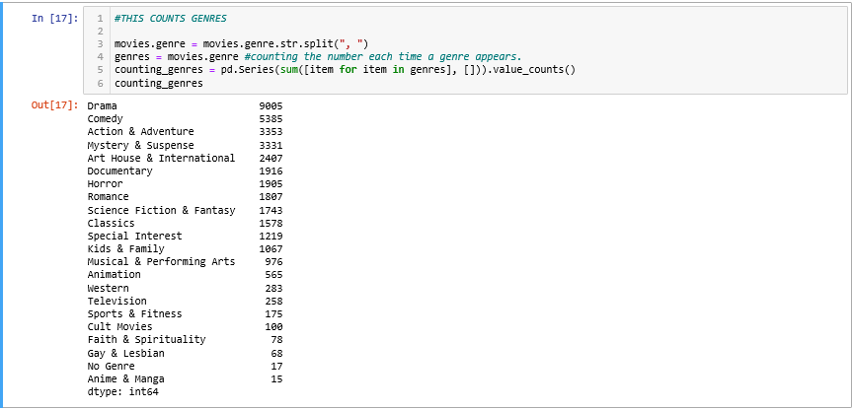
ANALYSIS

Slide 8
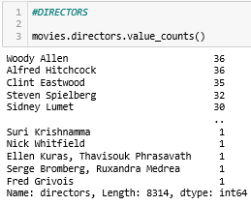
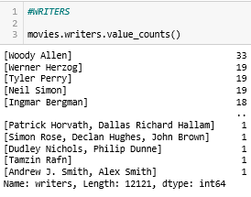
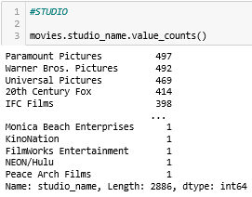
DOMINATING DIRECTORS ETC

Slide 9
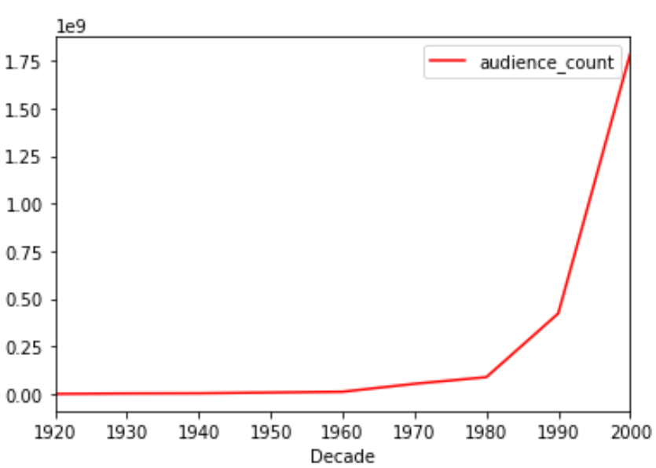
DEMAND FOR FILMS
It is worth keeping in mind that the trends we see could be reflected by the exponential growth in viewership

Slide 10
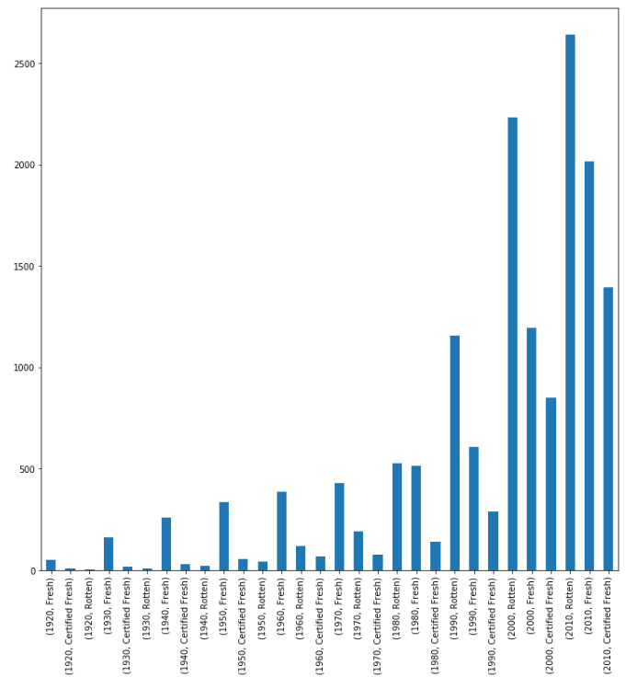
CRITICS RATINGS
From the 60s, Certified Fresh is overtaken by Rotten and from the 80s Rotten is the dominant critic review
Number of movies
Decade and critic status

Slide 11
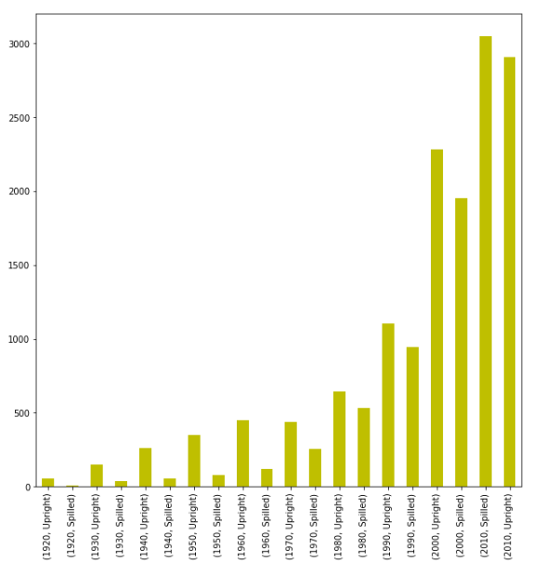
AUDIENCE RATINGS
2010+ is the only decade to feature more spilled movies than upright movies
Number of movies
Decade and audience status

Slide 12
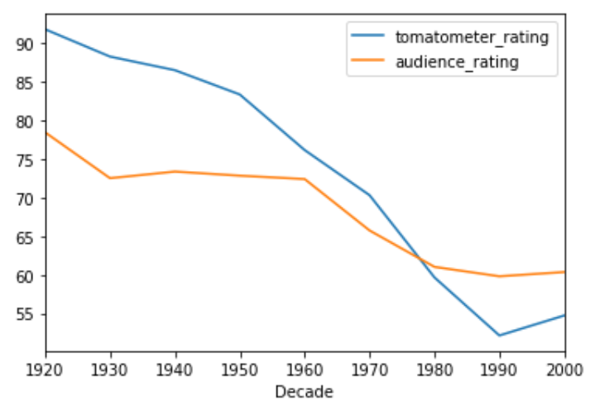
COMPARISON OF AUDIENCE AND CRITICS
Scores reach an all-time low in the 90s
Score /100

Slide 13
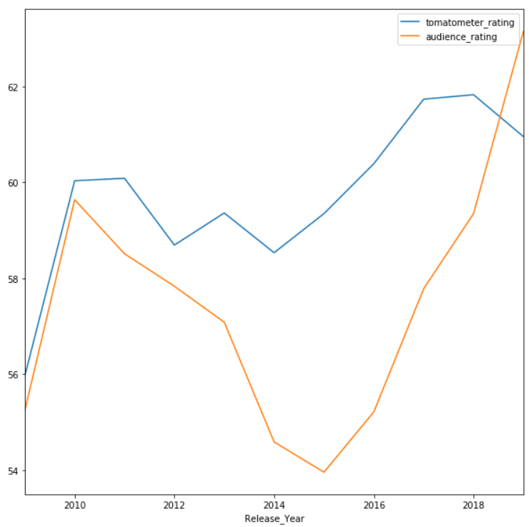
PAST TEN YEARS
General stable positive trend though plummets towards 2015
For reference, 2015 saw:
Spectre
50 Shades of Grey
SW: Force Awakens
Avengers: Age of Ultron
Score /100

Slide 14
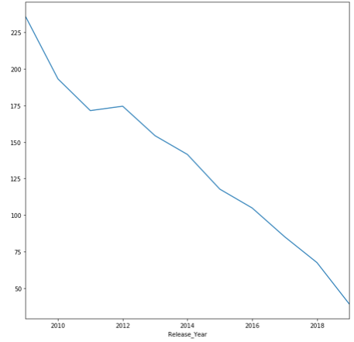
DELAY DURATION BETWEEN RELEASE AND STREAMING OVER THE PAST TEN YEARS
Number of days to streaming

Slide 15
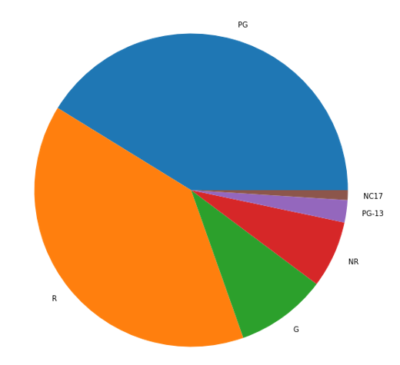
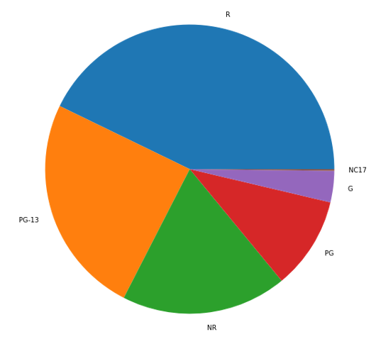
AGE-CLASS
1970-1980 Age Ratings
2000-2010 Age Ratings
Movies for more mature audiences are still as popular as ever, but the introduction of PG-13 has made a new market

Slide 16
CONCLUSION
Generally, movie ratings have been getting worse and worse since movies began. However, the turn of the 21st century has shown the first increase in ratings ever recorded. This could be due to technology catching up with the industry.
Over the past 10 years, films have become available to stream in far shorter amounts of time – the average stream delay seems to halve every 4-5 years, which is likely to cope with the viewership demand.

Slide 17
REFERENCES
Kaggle dataset source
https://www.kaggle.com/stefanoleone992/rotten-tomatoes-movies-and-critics-datasets/version/1
Rotten Tomatoes information
https://www.rottentomatoes.com/about#whatisthetomatometer
Why was 2015 so bad?
https://www.movieinsider.com/movies/-/2015

Slide 18
THANK YOU

